Slide 1
Bray Team Week 2 Update
Avery Haynes, Locke Lehmann, Travis Carlson, Cody Sims, Zachary Walker, Michael Hager
1/29/2024

Slide 2
Weekly Deliverables
Tasks | Lead | Percentage Done | Notes
Reserve storage and workspace in FEDC | Zack | 100% | Completed
Submit purchase request for supplies | Avery | 100% | Completed
Update Gantt Chart | Michael | 100% | Completed
Test sensor setup with valves and actuators | Cody/Travis | 0% | Awaiting arrival of supplies from purchase request
Setup weekly meetings with Bray | Locke | 100% | Sent email, awaiting response from Bray

Slide 3
Current Activities to Requirements
Reserve storage and workspace in FEDC
Formulate experimental design
Submit purchase request for supplies
Begin testing
Test sensor setup with valves and actuators

Slide 4
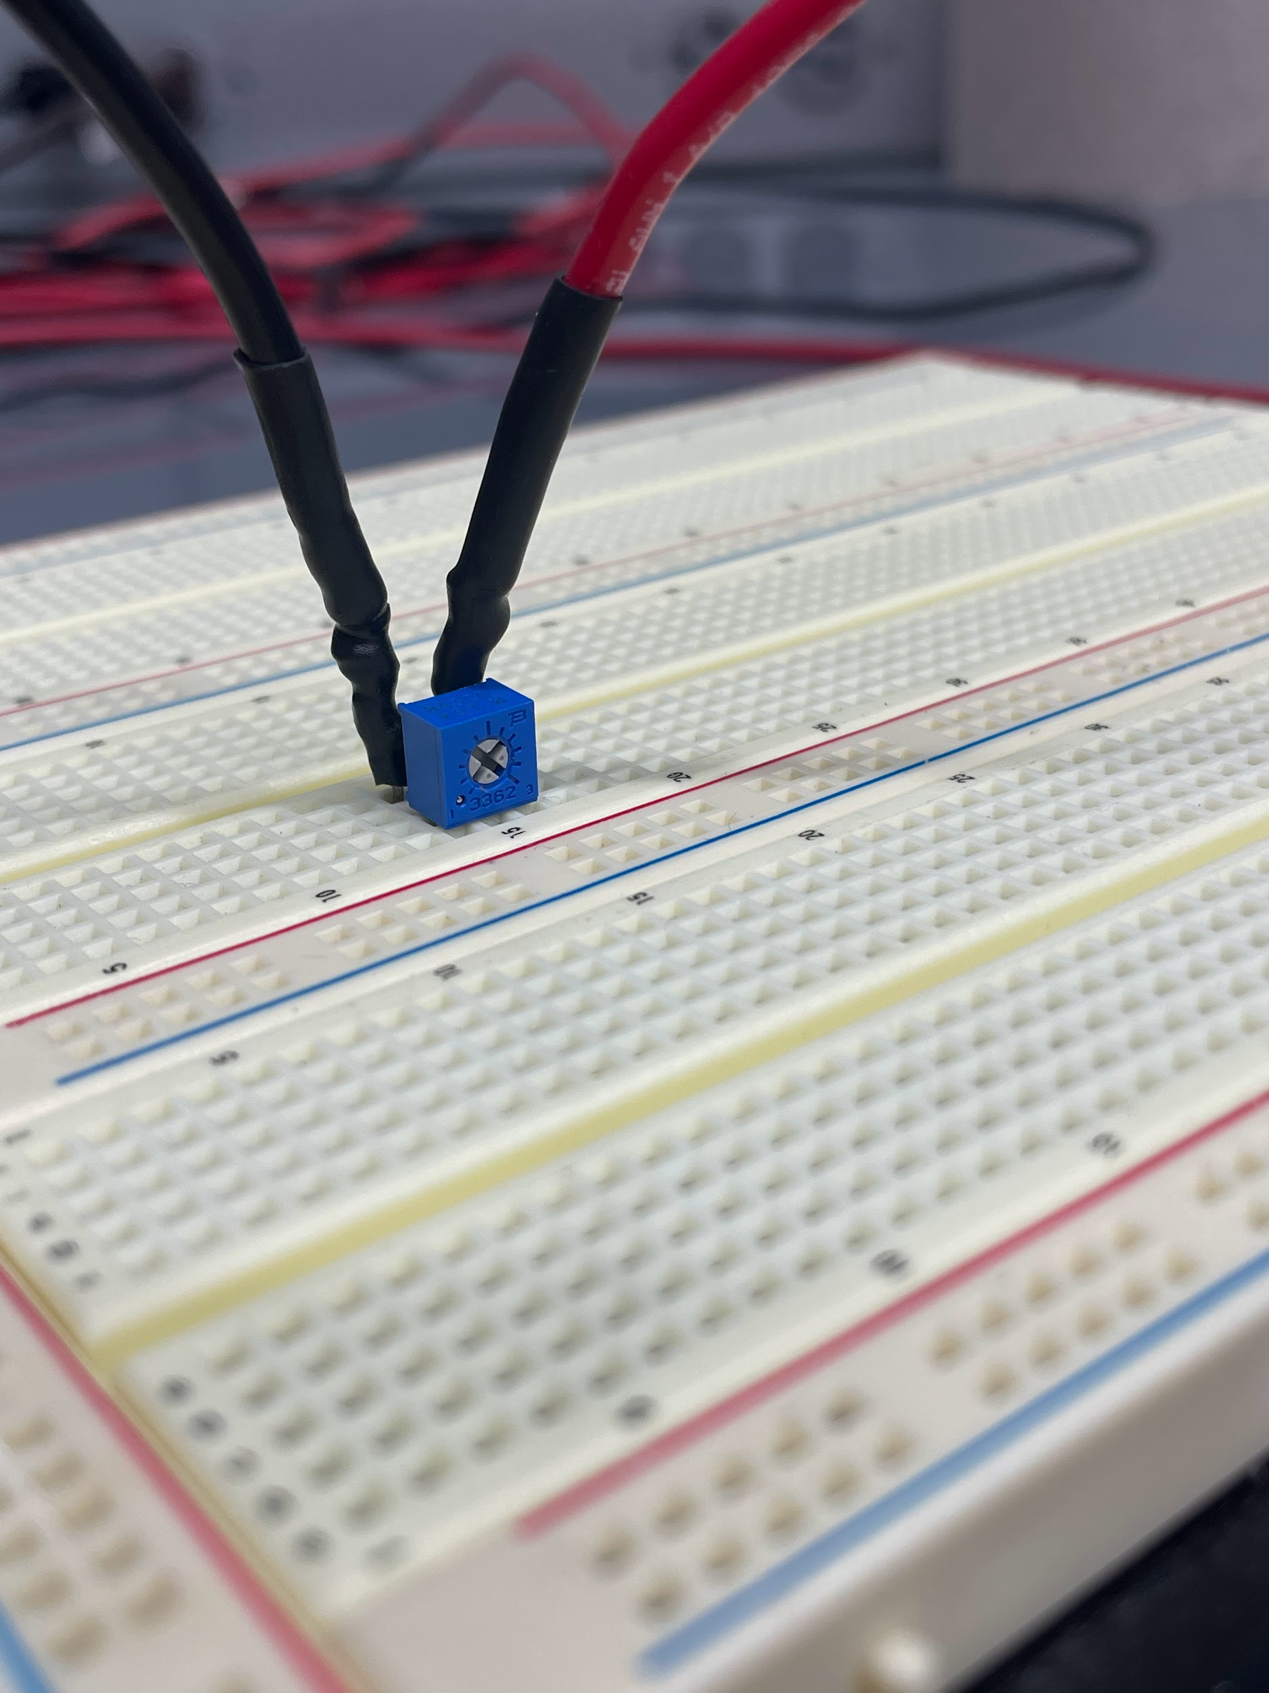
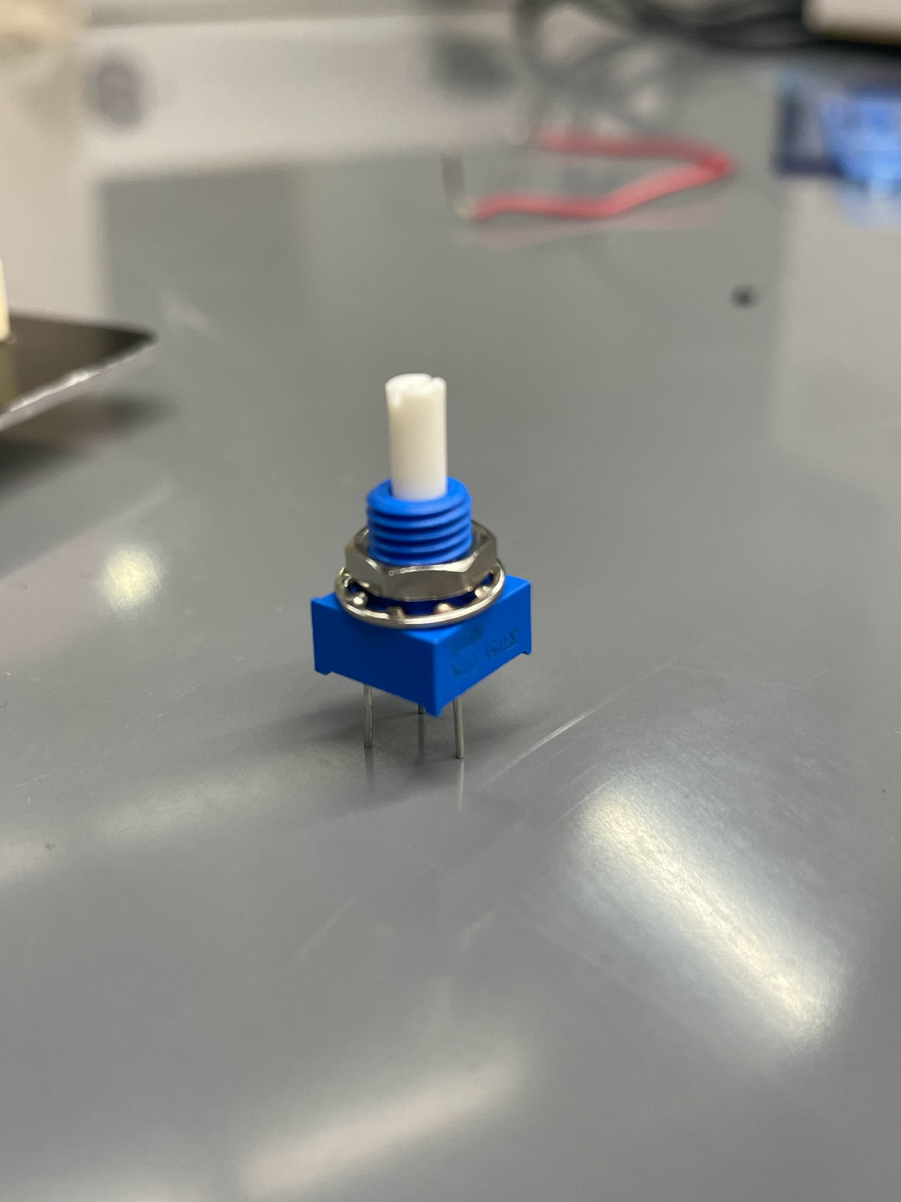
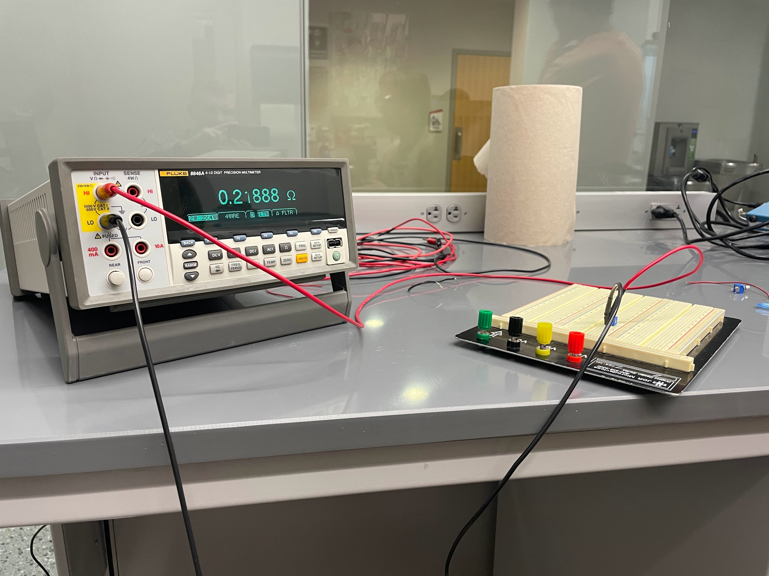
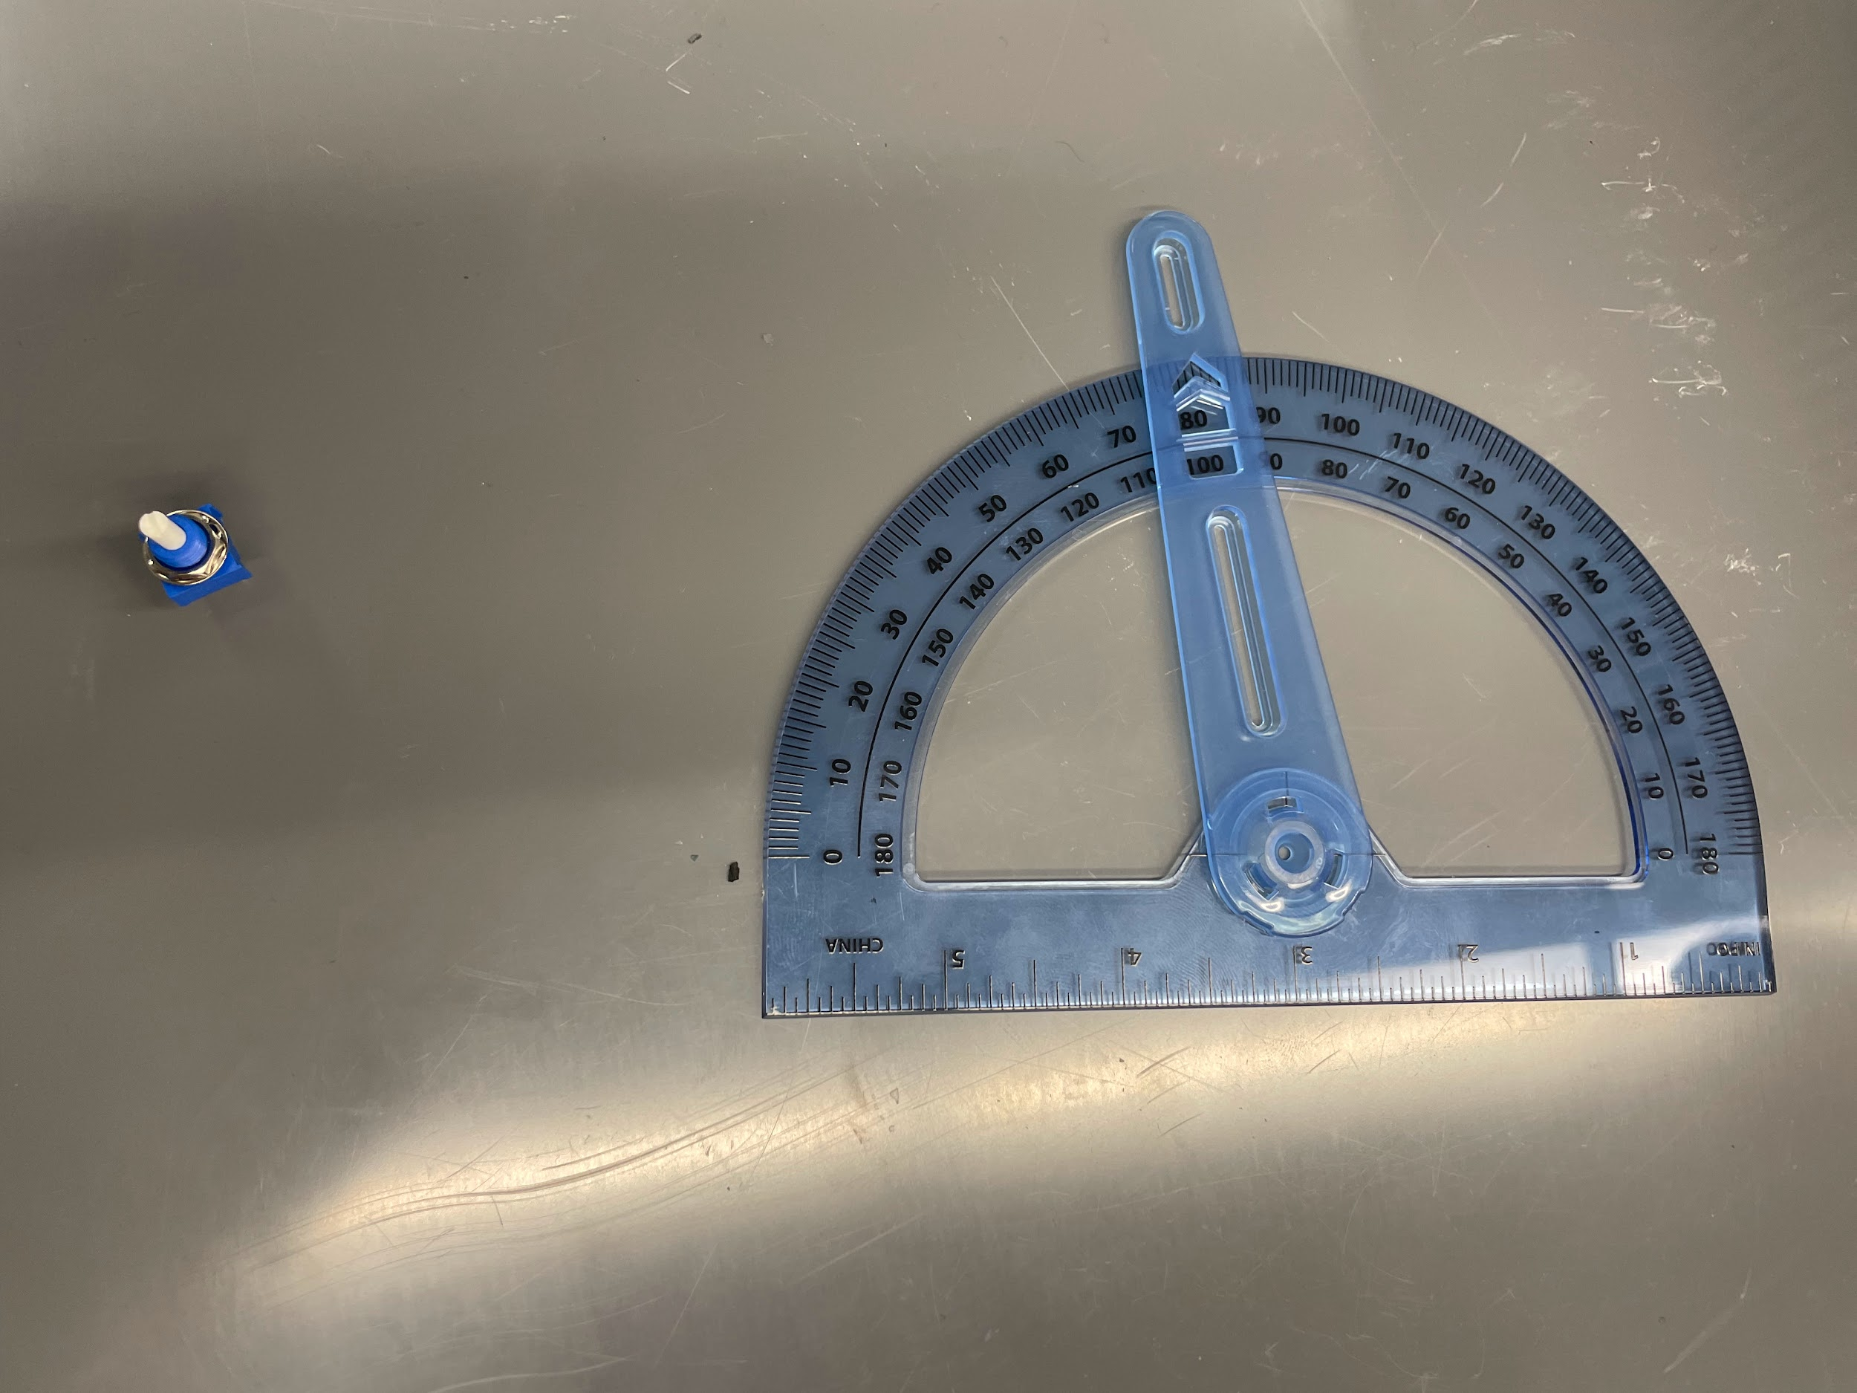
Initial Validation Testing

Slide 5
Initial Validation Testing
Tested resistance repeatedly at fully open and fully closed positions
Interpolated and tested to see if it was a linear trend - found it was mostly so with some deviations
Next: testing difference between using a logarithmic and linear scaled rotary potentiometers
0 avg | 0.2466666667
270 avg | 94704.28333
slope | 350.7556914
intercept | 0.2466666667 | Actual
90 expected ohms | 31568.25889 | 24500
180 expected ohms | 63136.27111 | 62480
135 expected ohms | 47352.265 | 42800

Slide 6
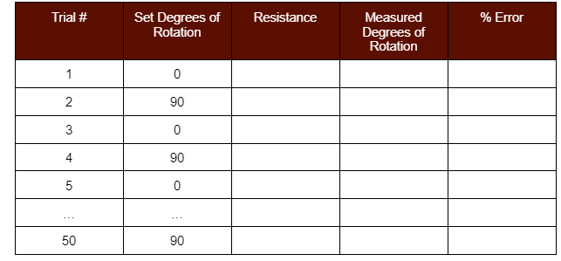
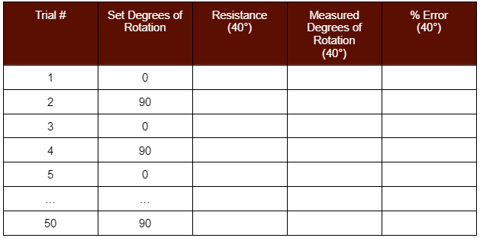
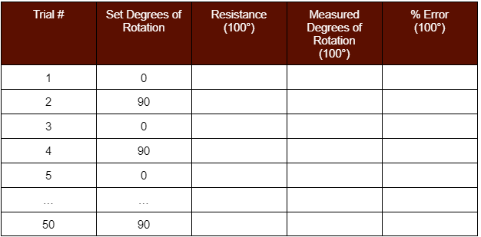
Experimental design: Potentiometer
Hypothesis: Design can achieve below 2% error from the actual rotational position of the ball valve under various temperature conditions.
Independent Variables: Rotational position of the valve, surrounding temperature
Dependent variables: % Error

Slide 7
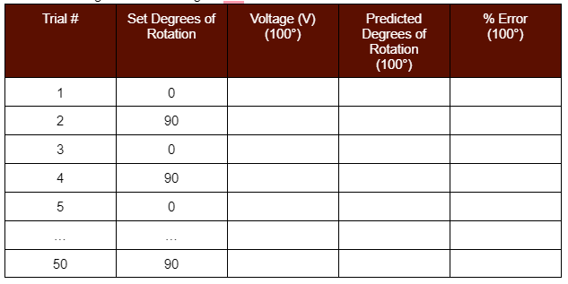
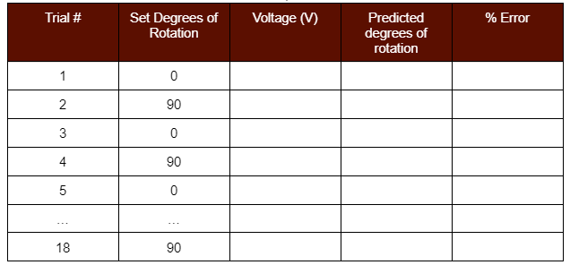
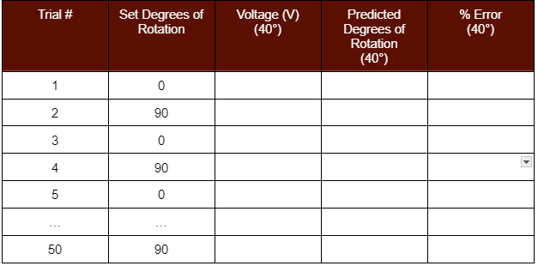
Experimental design: Hall effect sensor
Hypothesis: Design can achieve below 2% error from the actual rotational position of the ball valve/butterfly valve under various temperature conditions.
Independent Variables: Rotational position of the valve, surrounding temperature, distance between hall effect sensor and magnet.
Dependent variables: % Error
Initial distance testing: 0, 2, 4, 6, 8 ,10 mm

Slide 8
Budget/Materials Update
First round of parts ordered 1/15/24 (not arrived)
For testing position deliverable & collecting data ($128.27)
Asked Bray during today’s call to send materials for:
Activating & toggling actuators
Vice to support valves during testing
Exact hall effect sensor used in their traditional products
Will order supplies for torque deliverables this week
Bolt strain gauges, motor head & belt, additional casing

Slide 9
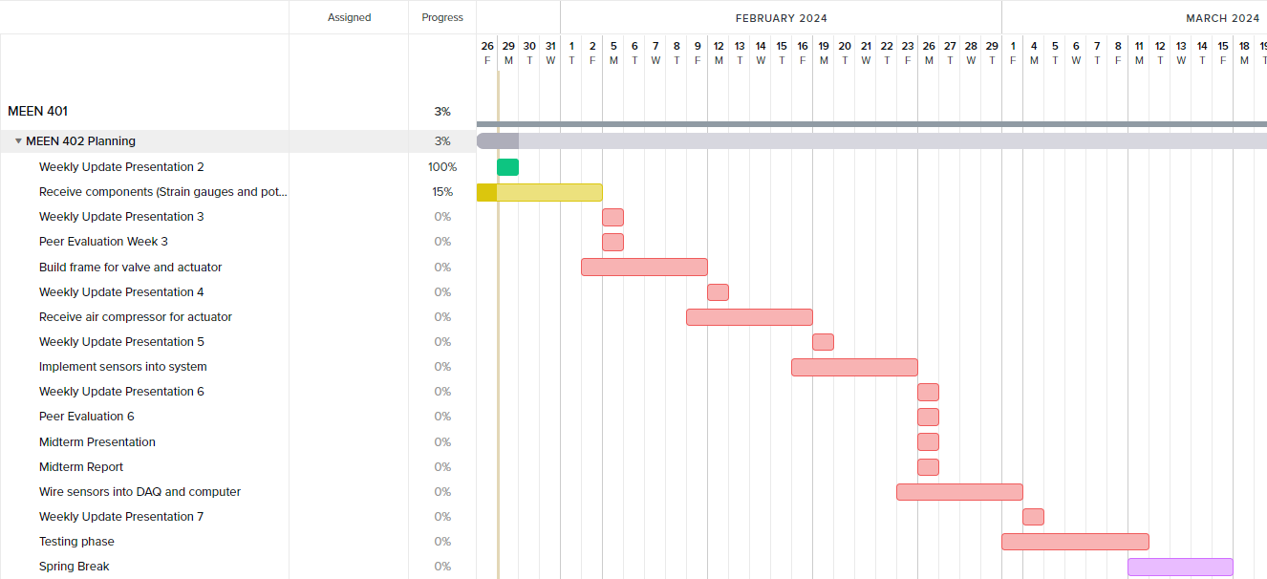
Gantt Chart

Slide 10
Next Week's Deliverables
Tasks | Lead | Percentage Done | Notes
Formulate experimental design for testing | Avery | 35% | Currently brainstorming.
Peer Evaluation | All | 0% | Have not started.
Test sensor setup with valves and actuators | Cody/Travis | 0% | Awaiting arrival of supplies from purchase request.
Setup weekly meetings with Bray | Locke | 100% | Sent email, awaiting response from Bray.
Research data analysis methods | Michael | 15% | Need to familiarize with Raspberry Pi data collection methods.

